Slide 1
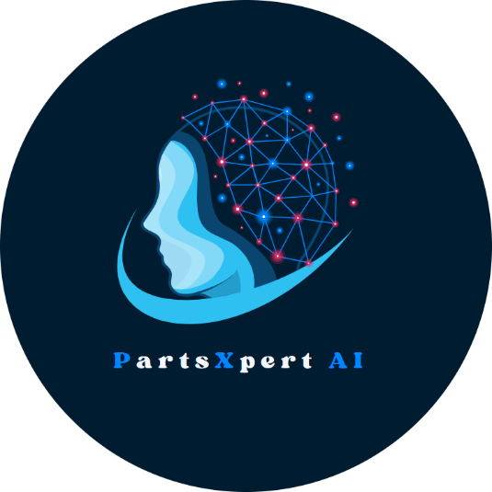




AI POWERED SMART COMPONENT MANAGEMENT
Author 1
Photo
Author 2
Photo
Author 3
Photo
Author 4
Photo
KARUNASAGARI S D
KAVIYA R
NAVEEN RAJ K
YOGHANAARAYANAN A
SRM TRP ENGINEERING COLLEGE
TIRCHIRAPPALLI
MS JEYAMEDONA P (AP/CSE)

Slide 2



CHALLENGE
EOL Identification
Manual identification of End-of-Life components using tools, which is time-consuming and prone to errors.
FFF Replacement
Extensive manual research required to find suitable Form, Fit, and Function replacements.
AI-Based Automation
The need for an AI system to automate EOL identification and FFF replacement suggestions efficiently.

Slide 3
APPROACH
Automated EOL Identification
AI predicts and identifies End-of-Life components automatically using lifecycle data.
Automated FFF Replacement
AI suggests accurate Form, Fit, and Function replacements using GNNs and reinforcement learning.
AI-Based System Integration
AI integrates with existing tools to automate the entire EOL identification and replacement process.

Slide 4
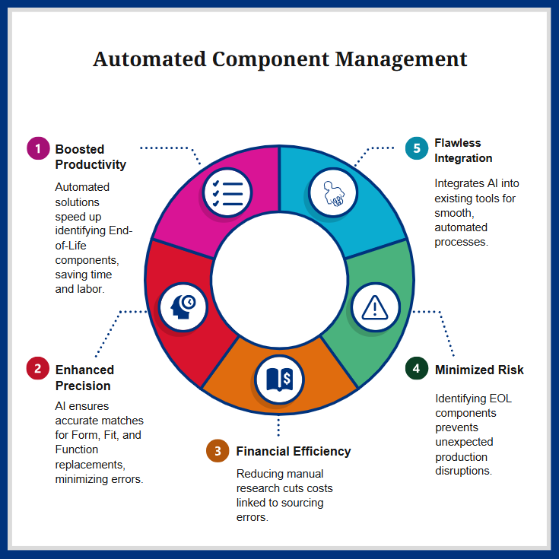
VALUE PROPOSITION
PROS
Automates EOL and FFF replacement processes, saving time and effort.
Reduces errors and ensures accurate component identification.
Predicts obsolescence early, enabling better planning and decision-making.
CONS
Accuracy depends on the availability and quality of data.
High initial setup costs for development and integration.
Requires regular updates to stay accurate and effective.

Slide 5
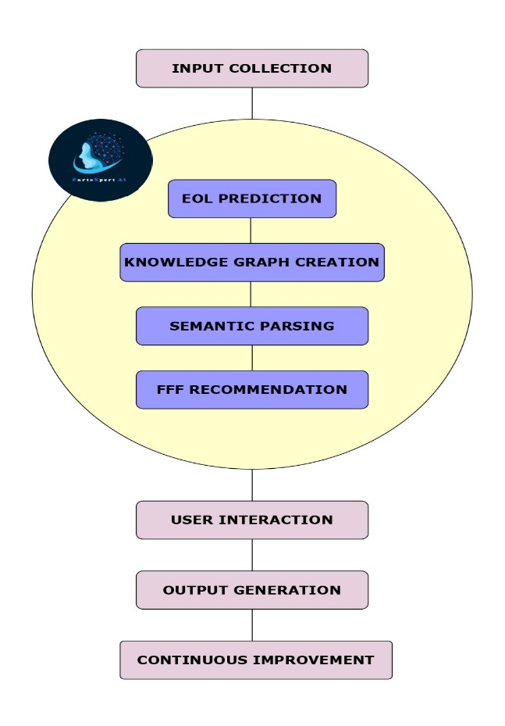
TECHNICAL STACK
WORKFLOW
Technical Stack
Frontend | React.js, HTML, CSS, Material-UI.
Backend | Python (FastAPI/Flask), PostgreSQL/MongoDB.
AI/ML | TensorFlow, PyTorch, Hugging Face Transformers.
Data Sources | IHS Markit, SiliconExpert APIs.
Integration | REST APIs, Docker, AWS/Google Cloud.
DevOps | GitHub Actions, Jenkins, Prometheus.

Slide 6
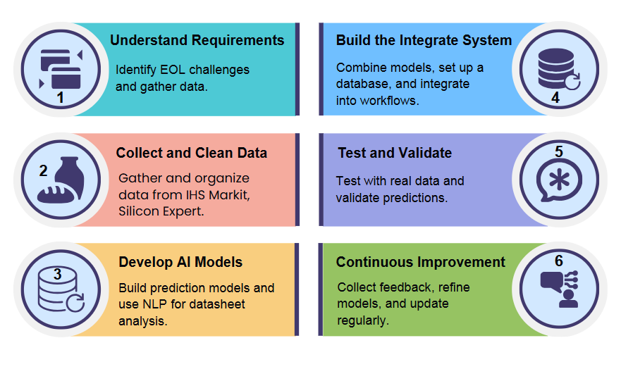
IMPLEMENTATION PLAN

Slide 7
EXECUTION FLOW
START
INSTALL DEPENDENCIES
CONFIGURE NGROK
INITIALIZE FASTAPI APPLICATION
AI MODEL SETUP
DATASHEET PARSING LOGIC
DEFINE API ENDPOINTS
START UVICORN SERVER
Execution Drive Link
ESTABLISH NGROK TUNNEL
https://drive.google.com/file/d/1iwtOgDaIZKsFl2ST_t3_TmzjcJY4Rk3i/view?usp=drivesdk
API TESTING
VIEW RESPONSES
4147- PDF Drive Link
https://drive.google.com/file/d/1jMOsYWr5njmlV-ydzVUYs_yS4Jv4_a1b/view?usp=drivesdk
END

Slide 8
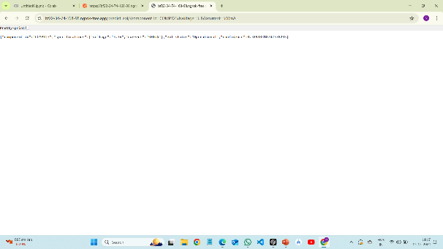
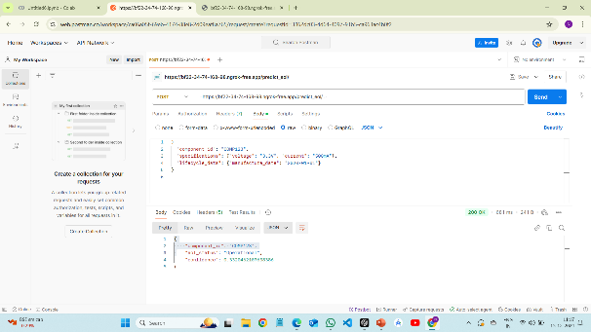
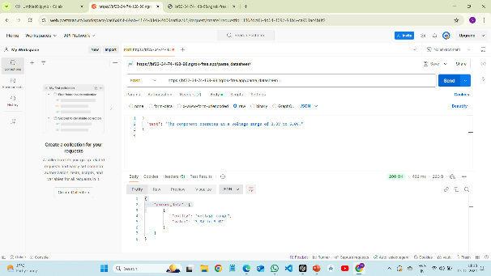
VALIDATION
(1) EOL Prediction→GET
(2) EOL Prediction→POST
(3) Datasheet Parsing→POST

Slide 9
COST ESTIMATION
AI/ML Model Development | ₹5,00,000 - ₹10,00,000
Frontend and Backend Development | ₹4,00,000 - ₹8,00,000
Data Collection and Integration | ₹3,00,000 - ₹5,00,000
Cloud Hosting (AWS, Google Cloud, Azure) | ₹1,50,000 - ₹3,00,000
Licensing for APIs (IHS Markit, SiliconExpert) | ₹2,00,000 - ₹5,00,000
AI/ML Libraries (TensorFlow, PyTorch) | ₹1,00,000 - ₹2,00,000
Third-Party Tools (Hugging Face, PyTorch Geometric) | ₹50,000 - ₹1,00,000
Server Maintenance | ₹50,000 - ₹1,00,000 per year
Model Retraining and Updates | ₹2,00,000 - ₹3,00,000 per year
AI Developers | ₹8,00,000 - ₹12,00,000 per year
Frontend/Backend Developers | ₹6,00,000 - ₹10,00,000 per year
Project Manager | ₹5,00,000 - ₹8,00,000 per year
Data Scientists | ₹7,00,000 - ₹12,00,000 per year
Total Estimated One-Time Development Cost | ₹20,00,000 - ₹40,00,000
Annual Maintenance Cost | ₹5,00,000 - ₹8,00,000
COST ESTIMATE

Slide 10



ASSUMPTIONS
Data Availability
Reliable and complete component data, including specifications and lifecycle information, is accessible from trusted sources.
Model Training
Sufficient historical data is available to train the AI models for accurate EOL predictions and FFF replacement suggestions.
System Integration
The AI system can be seamlessly integrated with existing tools and workflows without significant technical challenges.

Slide 11
CONCLUSION
The AI-powered solution automates EOL identification and FFF replacement, improving accuracy and reducing manual effort. By using advanced technologies like predictive analytics and natural language processing, it offers a scalable, cost-effective way to manage components. The system enhances decision-making and evolves with user feedback for continuous improvement, providing long-term benefits for industries.

Slide 12
REFERENCES
Input Collection
IHS Markit for lifecycle data.
EOL Prediction
AI and Supply Chain Management.
Knowledge Graph
AI lifecycle management (IEEE Xplore).
Semantic Parsing
LLMs for datasheet parsing.
FFF Recommendations
AI optimization (IEEE Xplore).
User Interaction
AI decision support (IEEE Xplore).
Continuous Improvement
Feedback loops (IEEE Xplore).

Slide 13
THANK YOU!

